Slide 1
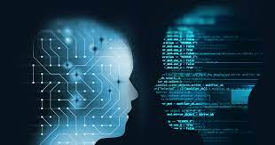
Data Science-AI The Future of Life

Slide 2
Introduction
Name: Omakr Nallagoni
Company: Cognizant
Experience: 12 Years
Designation: Lead Data scientist
MTech : JNTU Hyderabad
PG Diploma in Data Science : IIT Tirupati.
Lead Data science trainer at Naresh IT
Data Science SME at Naresh IT
Azure Data science Certified
GCP ML Engineer Certified
Collaborated with Praxis Business school, Brillo, Bhartiya Vidhya Peet, UpGrade, Spjain, IMS Pro schoo;
https://www.linkedin.com/in/nallagoni-omkar-783271188/

Slide 3
Agenda
The need for Data Science.
What is Data Science?
How is it different from Business Intelligence (BI) and Data Analysis?
The lifecycle of Data Science with the help of a use case.
Power of Data Science
What are Data Scientist
What is Machine learning
What is Generative AI – Chat GPT-GenAI

Slide 4
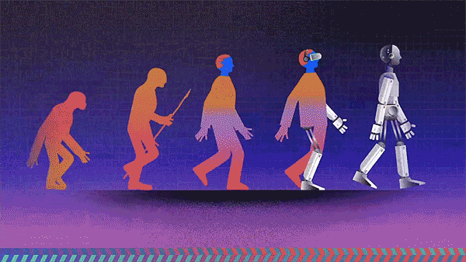
Will Show you two pictures now
Picture-1:
What is your thoughts on above picture ?

Slide 5
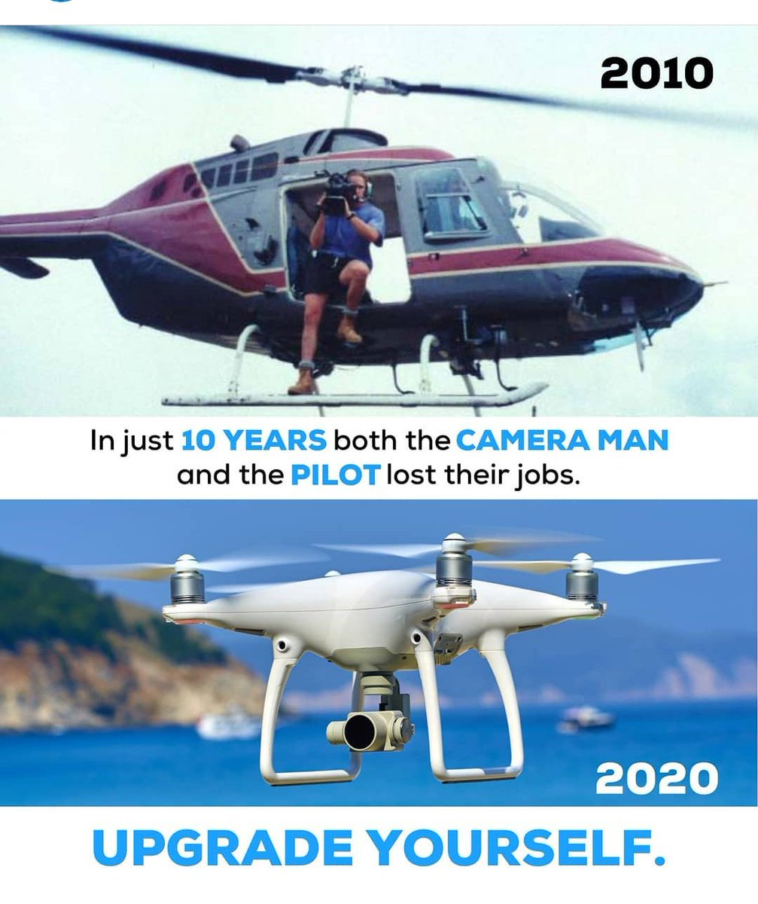
Picture-2
What is your thoughts on above picture ?

Slide 6
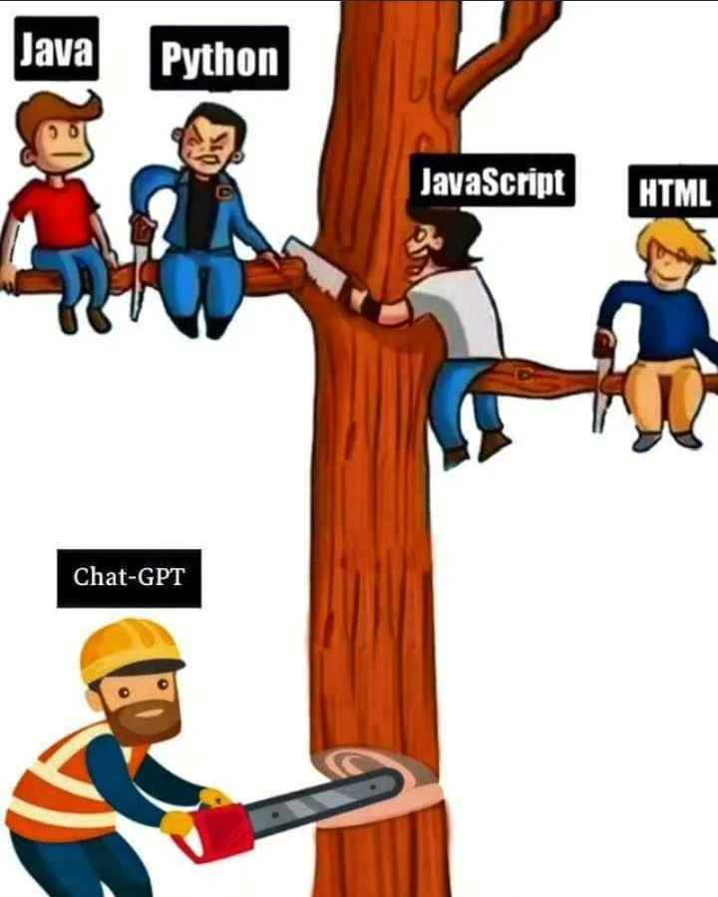
Picture-3
What is your thoughts on above picture ?

Slide 7
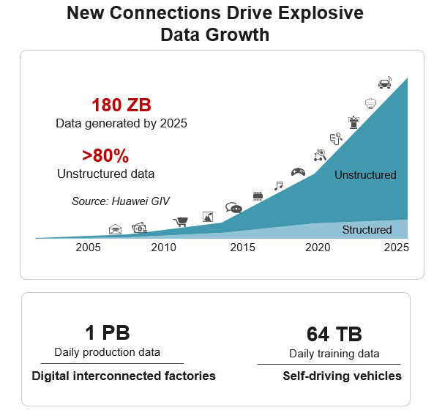
The need for Data Science
Traditionally, the data that we had was mostly structured and small, which could be analyzed by using the simple BI tools.
Unlike data in the traditional systems which was mostly structured,
today most of the data is unstructured or semi-structured.
Let’s have a look at the data trends in the image given below which shows that by 2020
more than 80 % of the data will be unstructured.
This data is generated from different sources like financial logs, text files, multimedia forms, sensors, and instruments.
Simple BI tools are not capable of processing this huge volume and variety of data.
Therefore, we need more complex and advanced analytical tools and algorithms for processing, analyzing and drawing meaningful insights out of it.

Slide 8
Structured data vs Unstructured data:
Structured data | Unstructured data
In the form of numbers and text, in standardized, readable formats. | Comes in a variety of shapes and sizes that does not conform to a predefined data model and remains in its native format.
Typically XML and CSV. | Typically, DOC, WMV, MPW, MP3, WAV. In data science applications we deals most of unstructured data only such as tf records, delta files, parquet files, avro files etc
Stored in a relational database in tablets, rows, and columns, with specific labels. Relational databases use SQL for processing. | Stored in unstructured raw formats or in a NoSQL database. Many companies use data lakes to store large volumes of unstructured data that they can then access when needed.

Slide 9

Let’s have a story of four brothers

Slide 10
Let’s assume we are doing a self driving project
Will attach so many cameras to identify the objects like persons, poles, cross roads, opposite vehicles
Per second It will generate so much data our normal PC’s are not useful to store the data, we need data lakes which is available through cloud only
Ones we store the data in cloud we need to analyze the data make sure it identifies all the objects correctly
Finally we need to secure the data
Technology Name?
Technology Name?
Technology Name?
Technology Name?
IOT
Cloud Computing
Data science-AI
Cyber security

Slide 11


Look at this tweet:
Amitabh Bachchan
shift the tournament WC 2019 to India .. we need the rain .. !!!
What do you think about this tweet ?

Slide 12
What Sentiment include in Amitabh tweet?
a)Shift Tournament WC 2019 to India? Positive only
b) Shift The rain? Positive only
c) Now add both a and b Sarcasm
But Data science –AI will say this is Sarcasm

Slide 13
Contd…
This is not the only reason why Data Science has become so popular. Let’s dig deeper and see how Data Science is being used in various domains.
How about if you could understand the precise requirements of your customers from the existing data like the customer’s past browsing history, purchase history, age and income. No doubt you had all this data earlier too, but now with the vast amount and variety of data, you can train models more effectively and recommend the product to your customers with more precision. Wouldn’t it be amazing as it will bring more business to your organization?
Let’s take a different scenario to understand the role of Data Science in decision making. How about if your car had the intelligence to drive you home? The self-driving cars collect live data from sensors, including radars, cameras and lasers to create a map of its surroundings. Based on this data, it takes decisions like when to speed up, when to speed down, when to overtake, where to take a turn – making use of advanced machine learning algorithms.
Let’s see how Data Science can be used in predictive analytics. Let’s take weather forecasting as an example. Data from ships, aircrafts, radars, satellites can be collected and analyzed to build models. These models will not only forecast the weather but also help in predicting the occurrence of any natural calamities. It will help you to take appropriate measures beforehand and save many precious lives.

Slide 14
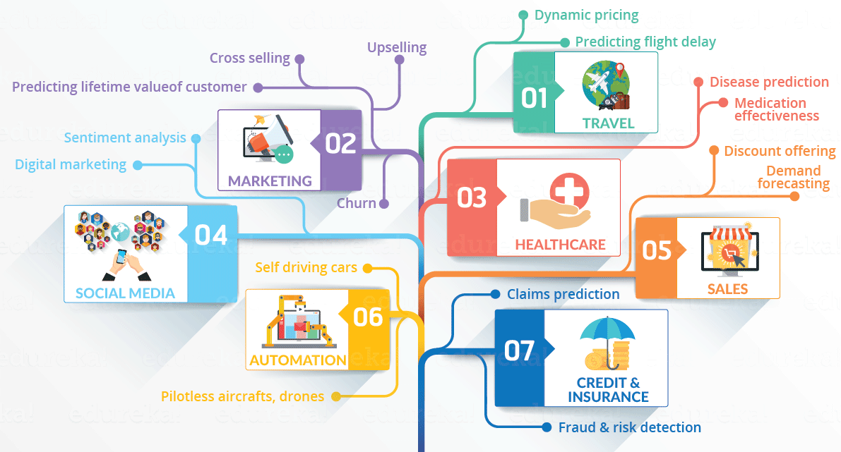
Contd..
Let’s have a look at the infographic to see all the domains where Data Science is creating its impression.

Slide 15
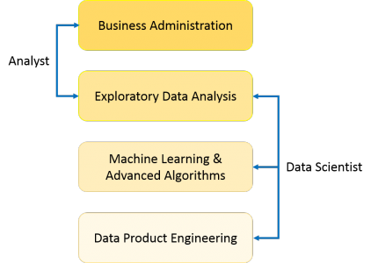
What is Data Science
Use of the term Data Science is increasingly common, but what does it exactly mean? What skills do you need to become Data Scientist? What is the difference between BI and Data Science? How are decisions and predictions made in Data Science? These are some of the questions that will be answered further.
First, let’s see what is Data Science. Data Science is a blend of various tools, algorithms, and machine learning principles with the goal to discover hidden patterns from the raw data. How is this different from what statisticians have been doing for years?
As you can see from this image, a Data Analyst usually explains what is going on by processing history of the data. On the other hand, Data Scientist not only does the exploratory analysis to discover insights from it, but also uses various advanced machine learning algorithms to identify the occurrence of a particular event in the future. A Data Scientist will look at the data from many angles, sometimes angles not known earlier.

Slide 16
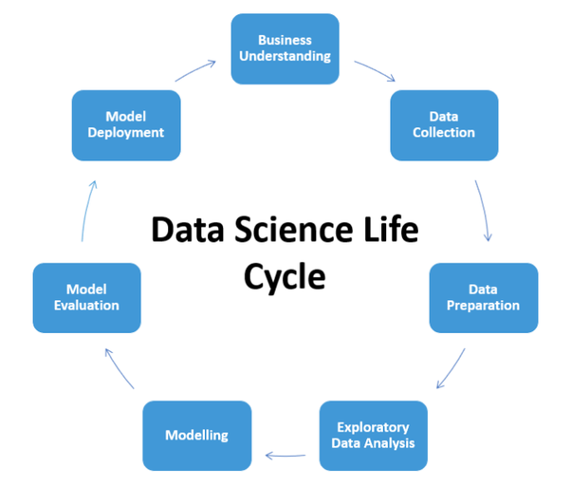
Life Cycle of Data Science

Slide 17
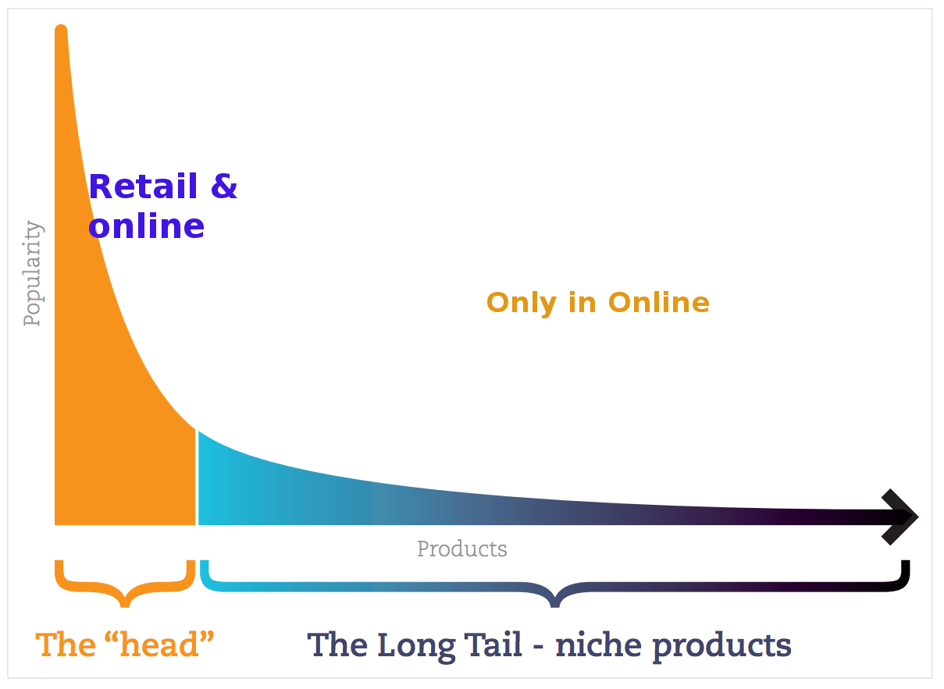
Power Of Data Science:
Recommendation Engine:

Slide 18
In 1988, a British mountain climber named Joe Simpson wrote a book called Touching the Void, a harrowing account of near death in the Peruvian Andes. It got good reviews but, only a modest success, it was soon forgotten. Then, a decade later, a strange thing happened. Jon Krakauer wrote Into Thin Air, another book about a mountain-climbing tragedy, which became a publishing sensation. Suddenly Touching the Void started to sell again.
Random House rushed out a new edition to keep up with demand. Booksellers began to promote it next to their Into Thin Air displays, and sales rose further. A revised paperback edition, which came out in January, spent 14 weeks on the New York Times bestseller list. That same month, IFC Films released a docudrama of the story to critical acclaim. Now Touching the Void outsells Into Thin Air more than two to one.
What happened? In short, Amazon.com recommendations. The online bookseller's software noted patterns in buying behavior and suggested that readers who liked Into Thin Air would also like Touching the Void. People took the suggestion, agreed wholeheartedly, wrote rhapsodic reviews. More sales, more algorithm-fueled recommendations, and the positive feedback loop kicked in.
https://www.amazon.co.uk/Into-Thin-Touching-Books-Collection/dp/9123820950

Slide 19
What Does Data Scientist Do?
It is becoming clear by the day that there is enormous value in data processing and analysis—and that is where a data scientist steps into the spotlight.
Here are some advantages of data science in business:
Mitigating risk and fraud. Data scientists are trained to identify data that stands out in some way. They create statistical, network, path, and big data methodologies for predictive fraud propensity models and use those to create alerts that help ensure timely responses when unusual data is recognized.
Delivering relevant products. One of the advantages of data science is that organizations can find when and where their products sell best. This can help deliver the right products at the right time—and can help companies develop new products to meet their customers’ needs.
Personalized customer experiences. One of the most buzzworthy benefits of data science is the ability for sales and marketing teams to understand their audience on a very granular level. With this knowledge, an organization can create the best possible customer experiences.

Slide 20

Requirements To Become Data Scientist

Slide 21

AI-Deep Learning-Machine Learning
When we talk about data science
It includes all 3 domains like
Artificial intelligence
Machine Learning
Deep Learning

Slide 22
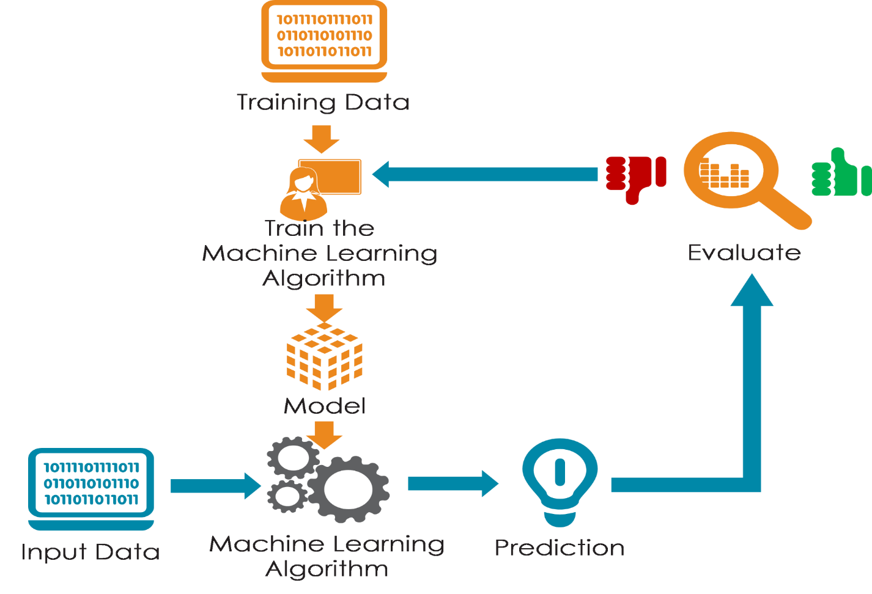
Introduction to Machine Learning
Q) What is Machine Learning why it is Important:
Machine learning focuses on the development of computer programs that can teach themselves to grow and change when exposed to new data.

Slide 23
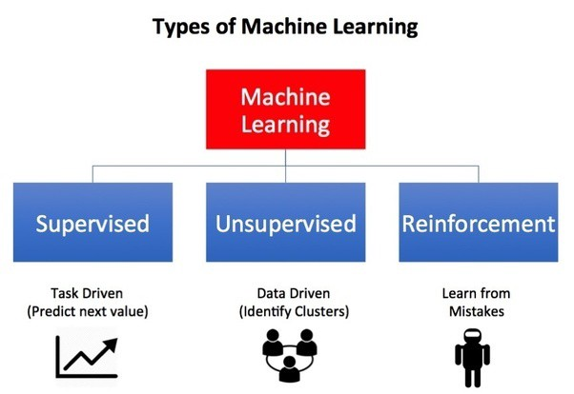
Types Of Learnings
1)Supervised Learning(Classification):
Supervised machine learning algorithms can apply what has been learned in the past to new data using labeled examples to predict future events. Starting from the analysis of a known training dataset, the learning algorithm produces an inferred function to make predictions about the output values.
What is it mean?
suppose you have a data like this
Input output
X=1 — — — — — — ->Y=1
X=2 — — — — — — →Y=4
X=3 — — — — — — →Y=9
X=4 — — — — — — →Y=16……..and so on
Now X=20 then what is Y=?

Slide 24
Supervised Learning
Classification
Regression
1)Decision Tress
2)Navi Bayes
3)Support vector Machines
4)K-Nearest Neighbors
5)Collaborative Filtering
6)Logistic regression
1)Linear Regression
2)Lasso Regression
3)Ridge Regression etc..

Slide 25
2)Unsupervised-Learning(Cluster Analysis):
Unsupervised machine learning algorithms are used when the information used to train is neither classified nor labeled. Unsupervised learning studies how systems can infer a function to describe a hidden structure from unlabeled data. The system doesn’t figure out the right output, but it explores the data and can draw inferences from datasets to describe hidden structures from unlabeled data.
Ex: Identify the pattern of sales, Image segmentation, customer segmentation
Unsupervised Learning
1)K-Means
2)K-Medoids
3)Hierarchical Cluster
4)Density Based Cluster

Slide 26
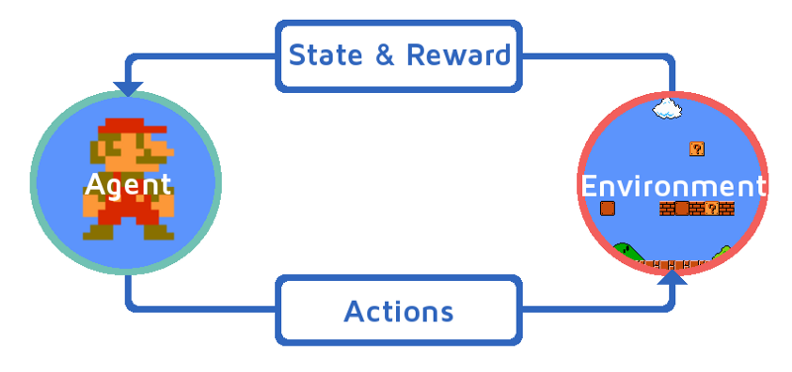
3)Reinforcement Learning:
Reinforcement learning, in the context of artificial intelligence, is a type of dynamic programming that trains algorithms using a system of reward and punishment. A reinforcement learning algorithm, or agent, learns by interacting with its environment.
Ex: Robotics, self driving cars, Alexa etc..

Slide 27

Generative AI
Write a tagline for an ice cream shop
I’m having trouble getting
my Ybox to turn on.
Table customers, columns=[CustomerId,FirstNAme,LasrName,Company,Address,City,State,Country,PostalCode]
Create a SQL query for all customers in Texas names jane query=
A ball of fire with vibrant colours to show the speed of innovation at our media and entertainment company
Prompt
Prompt
Prompt
Prompt
Response
We serve up smiles with every scoop!
Response
There are a few things you can try to troubleshoot this issue - -
Response
Response
SELECT * FROM Customers WHERE State=‘TX’ AND FirstName=‘Jane’
Thanks! That worked. What games do you recommend for
my 14-year-old?
Prompt
Response
Here are a few games that you might consider: -

Slide 28
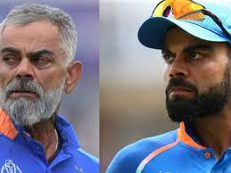
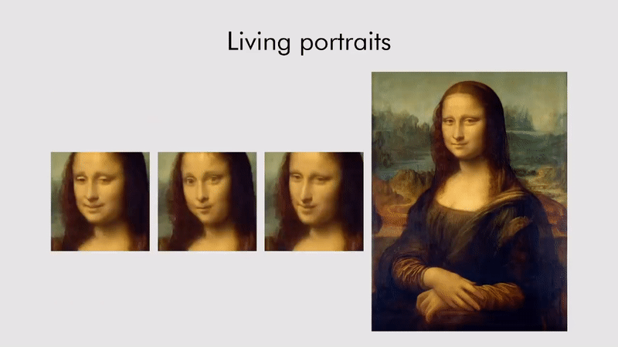
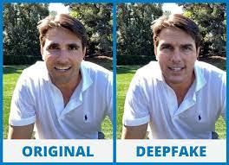

Slide 29

What you Can achieve at end of the Course

Slide 30
Data analysis Python Deployment
Machine learning applications SQL Mlflow
Deep Learning applications Power BI Azure AI services
NLP Applications Flask BERT
Generative AI applications POSTMAN
Visualizations PySpark
Cloud applications(AzureML) Streamlit apps
Statistics DataBricks
Maths Docker
Time series applications Github
LLM LangChain

Slide 31
Quality Training
Certifications
Internships
Placement support
Daily Assignments
Presentation
Blogs and content writing
Doubts clarification
Special trainings on request
24*7 Availability

Slide 32
Naresh IT certification
NAASCOM certification
Classroom recordings
Live Virtual Lab mentorship
Offline Lab 8am to 8pm
Placement assistance
Google class room Access life time
Weekly exams
Screening Test
Materials

Slide 33
Thank You
OMKAR N
Lead Data scientist
https://www.linkedin.com/in/nallagoni-omkar-783271188/
https://medium.com/@omkar.nallagoni
omkar.nallagoni@gmail.com

